Slide 1


Jaydeep Jitendra
26/10/2021

Slide 2

Outline
Executive Summary
Introduction
Methodology
Results
Conclusion
Appendix

Slide 3
Executive Summary
Summary of methodologies
Data Collection
Data Wrangling
EDA with data visualization
EDA with SQL
Building an interactive map with Folium
Building a Dashboard with Plotly Dash
Predictive Analysis
Summary of all results
Exploratary data analysis results
Interactive analytics demo in screenshots
Predictive analysis results

Slide 4
Introduction
In this project we will try to predict if Falcon 9 first stage will land successfully or not by using previous data and different regression analysis.
We will discuss through the problem and how to find solutions:
How to predict if the rocket will land successfully
For successful landing what efforts SpaceX will have to make to achieve best results.
How different parameters such as rocket parameters, location and etc can impact on determining the success rate of a successful landing.

Slide 5


Slide 6
Methodology
Executive Summary
Data collection methodology:
Data was collecting from past SpaceX missions. From below URL
https://api.spacexdata.com/v4/launches/past
Web scrapping from Wikipedia
Perform data wrangling
Calculated the number of launches on each site
Calculated number and occurrences of each orbit
Calculated the number and occurrence of mission outcome per orbit type
Created a landing outcome label from Outcome column
Perform exploratory data analysis (EDA) using visualization and SQL
Perform interactive visual analytics using Folium and Plotly Dash
Perform predictive analysis using classification models

Slide 7
Data Collection
Data sets were collected from previous SpaceX mission and Wikipedia pages and below processes were obtained to clean the data.
SpaceX API – converted data into .csv file
Web Scrapping – using beautiful soup and normalised data
Data Wrangling

Slide 8
Data Collection – SpaceX API
https://github.com/jaydeep-j/SpaceX_Capstone_Project/blob/master/jupyter-labs-spacex-data-collection-api.ipynb
Request and parse the SpaceX launch data using the GET request
Filter the Data frame to only include Falcon 9 launches
Replace Missing Values with mean Value

Slide 9
Data Collection - Scraping
https://github.com/jaydeep-j/SpaceX_Capstone_Project/blob/master/jupyter-labs-webscraping.ipynb
Request the Falcon9 Launch Wiki page from its URL
Extract all column/variable names from the HTML table header
Create a data frame by parsing the launch HTML tables

Slide 10
Data Wrangling
Calculate the number of launches on each site
Calculate the number and occurrence of each orbit
Calculate the number and occurrence of mission outcome per orbit type
Create a landing outcome label from Outcome column
https://github.com/jaydeep-j/SpaceX_Capstone_Project/blob/master/labs-jupyter-spacex-Data%20wrangling.ipynb

Slide 11
EDA with Data Visualization
Plotted below charts to understand the data.
Flight Number Vs Payload variables, how it would affect the launch outcome.
Flight Number vs Launch Site
Payload vs Launch Site
Success rate vs Orbit type
Flight Number vs Orbit type
Payload vs Orbit type
launch success yearly trend
https://github.com/jaydeep-j/SpaceX_Capstone_Project/blob/master/jupyter-labs-eda-dataviz.ipynb

Slide 12
EDA with SQL
Display the names of the unique launch
Display the total payload mass carried by boosters
List the total number of successful and failure mission outcomes.
List the records which will display the month names, failure landing_outcomes in drone ship ,booster versions, launch_site for the months in year 2015
Rank the count of successful landing_outcomes between the date 2010-06-04 and 2017-03-20 in descending order.
List the date when the first succesful landing outcome in ground pad was acheived.
https://github.com/jaydeep-j/SpaceX_Capstone_Project/blob/master/jupyter-labs-eda-sql-coursera.ipynb

Slide 13
Build an Interactive Map with Folium
Mark all launch sites on a map
Add folium.Circle & folium.Marker on each site
Mark the success/failed launches for each site on the map
Calculate the distances between a launch site to its proximities
Calculate the distance to nearest railway
Use polyline function to show the distance
The launch success rate may depend on many factors such as payload mass, orbit type, and so on. It may also depend on the location and proximities of a launch site, i.e., the initial position of rocket trajectories. Finding an optimal location for building a launch site certainly involves many factors.
https://github.com/jaydeep-j/SpaceX_Capstone_Project/blob/master/lab_jupyter_launch_site_location%20with%20Folium.ipynb

Slide 14
Build a Dashboard with Plotly Dash
Summarize what plots/graphs and interactions you have added to a dashboard
Explain why you added those plots and interactions
Add the GitHub URL of your completed Plotly Dash lab, as an external reference and peer-review purpose

Slide 15
Predictive Analysis (Classification)
Use the function train_test_split to split the data X and Y into training and test data
Create a logistic regression object and calculate the accuracy
Create a support vector machine object and calculate the accuracy
Create a decision tree classifier object and calculate the accuracy
Create a k nearest neighbors object and calculate the accuracy
Find the best performing method
Split the data for training and testing, and performed regression analysis methods such as SVM, Classification trees and Logistic Regression to find the best hyperparameters and accuracy of the model.
https://github.com/jaydeep-j/SpaceX_Capstone_Project/blob/master/SpaceX%20Machine%20Learning%20Predictive%20Analysis.ipynb

Slide 16
Results
Exploratory data analysis results
Interactive analytics demo in screenshots
Predictive analysis results

Slide 17


Slide 18
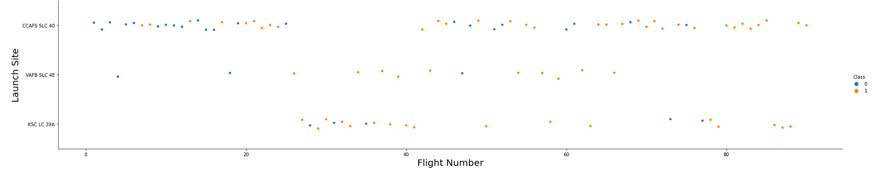
Flight Number vs. Launch Site
Scatter plot of Flight Number vs. Launch Site
Explanation: The more amount of flights at a launch site the greater the success rate at a launch site.

Slide 19
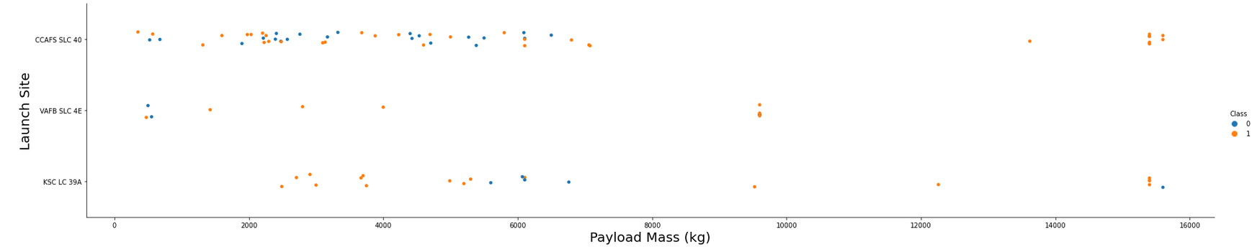
Payload vs. Launch Site
Scatter plot of Payload vs. Launch Site
Explanations: The greater the payload mass for Launch Site CCAFS SLC 40 the higher the success rate for the Rocket. There is not quite a clear pattern to be found using this visualization to make a decision if the Launch Site is dependant on Pay Load Mass for a success launch.

Slide 20
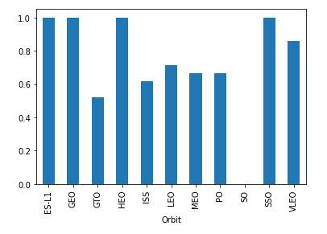
Success Rate vs. Orbit Type
Bar chart for the success rate of each orbit type
Explanations: Orbit GEO,HEO,SSO,ES-L1 has the best Success Rate

Slide 21
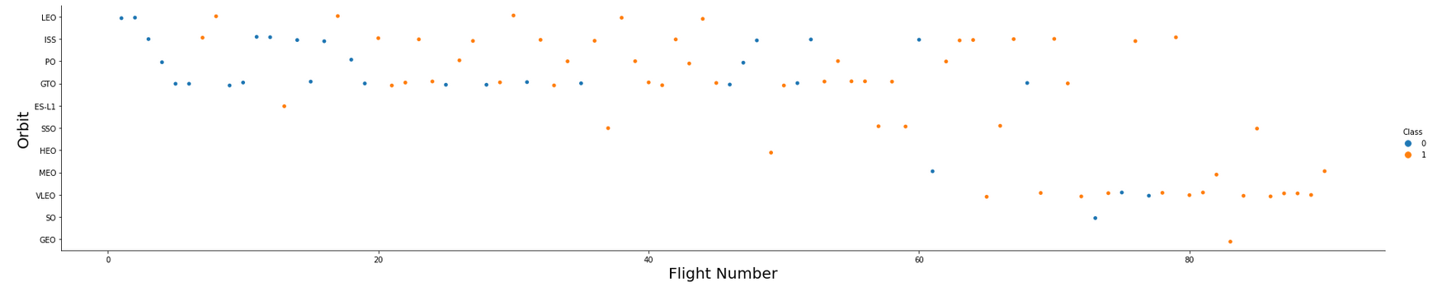
Flight Number vs. Orbit Type
Scatter point of Flight number vs. Orbit type
Explanations : You should see that in the LEO orbit the Success appears related to the number of flights; on the other hand, there seems to be no relationship between flight number when in GTO orbit.

Slide 22
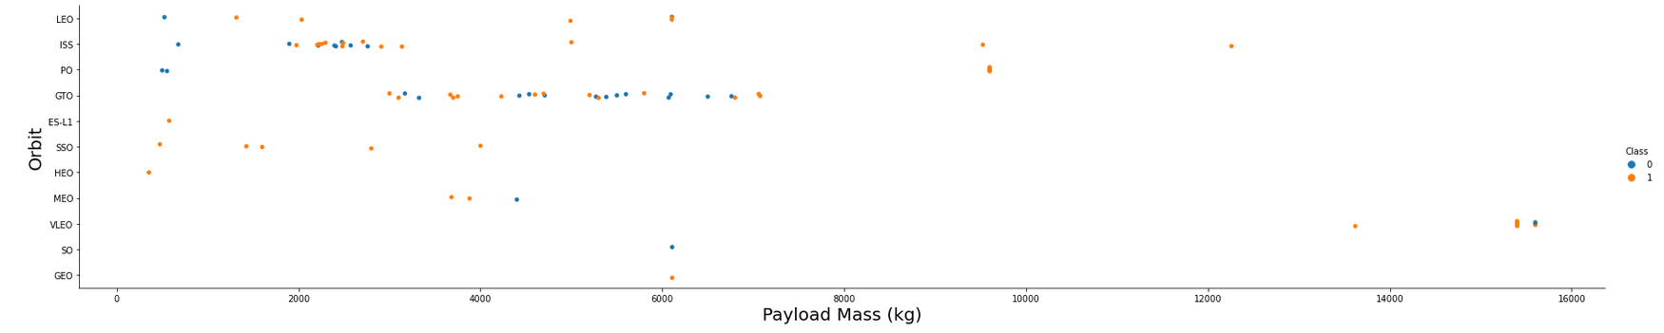
Payload vs. Orbit Type
Scatter point of payload vs. orbit type
Explanations: You should observe that Heavy payloads have a negative influence on GTO orbits and positive on GTO and Polar LEO (ISS) orbits.

Slide 23
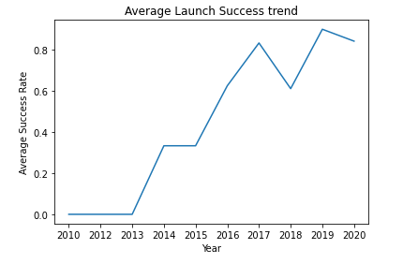
Launch Success Yearly Trend
Line chart of yearly average success rate.
Explanations : It can be observed that the success rate kept increasing since 2013 to 2020.

Slide 24
All Launch Site Names
Names of the unique launch sites:
Cape Canaveral Space Launch Complex 40 VAFB SLC 4E
Vandenberg Air Force Base Space Launch Complex 4E (SLC-4E)
Kennedy Space Center Launch Complex 39A KSC LC 39A
Query explanation: Using the word DISTINCT in the query means that it will only show Unique values in the Launch_Site column from tblSpaceX

Slide 25
Launch Site Names Begin with 'CCA'
5 records where launch sites begin with `CCA`
DATE | time__utc_ | booster_version | launch_site | payload | payload_mass__kg_ | orbit | customer | mission_outcome | landing__outcome
2010-06-04 | 18:45:00 | F9 v1.0 B0003 | CCAFS LC-40 | Dragon Spacecraft Qualification Unit | 0 | LEO | SpaceX | Success | Failure (parachute)
2010-12-08 | 15:43:00 | F9 v1.0 B0004 | CCAFS LC-40 | Dragon demo flight C1, two CubeSats, barrel of Brouere cheese | 0 | LEO (ISS) | NASA (COTS) NRO | Success | Failure (parachute)
2012-05-22 | 07:44:00 | F9 v1.0 B0005 | CCAFS LC-40 | Dragon demo flight C2 | 525 | LEO (ISS) | NASA (COTS) | Success | No attempt
2012-10-08 | 00:35:00 | F9 v1.0 B0006 | CCAFS LC-40 | SpaceX CRS-1 | 500 | LEO (ISS) | NASA (CRS) | Success | No attempt
2013-03-01 | 15:10:00 | F9 v1.0 B0007 | CCAFS LC-40 | SpaceX CRS-2 | 677 | LEO (ISS) | NASA (CRS) | Success | No attempt

Slide 26
Total Payload Mass
Total payload carried by boosters from NASA
Explanation : Using the function SUM summates the total in the column PAYLOAD_MASS_KG_, The WHERE clause filters the dataset to only perform calculations on Customer NASA (CRS)
total_payload_mass
45596

Slide 27
Average Payload Mass by F9 v1.1
Average payload mass carried by booster version F9 v1.1
Explanation : Using the function AVG works out the average in the column PAYLOAD_MASS_KG_
average_payload_mass
2928

Slide 28
First Successful Ground Landing Date
Dates of the first successful landing outcome on ground pad
Explanation : Using the function MIN works out the minimum date in the column Date
first_succesful_landing
2015-12-22

Slide 29
Successful Drone Ship Landing with Payload between 4000 and 6000
Names of boosters which have successfully landed on drone ship and had payload mass greater than 4000 but less than 6000
Explanation : Selecting only Booster_Version The WHERE clause filters the dataset to Landing_Outcome = Success (drone ship) The AND clause specifies additional filter conditions Payload_MASS_KG_ > 4000 AND Payload_MASS_KG_ < 6000
booster_version
F9 FT B1022
F9 FT B1026
F9 FT B1021.2
F9 FT B1031.2

Slide 30
Total Number of Successful and Failure Mission Outcomes
Total number of successful and failure mission outcomes
mission_outcome | 2
Failure (in flight) | 1
Success | 99
Success (payload status unclear) | 1

Slide 31
Boosters Carried Maximum Payload
booster_version | payload_mass__kg_
F9 B5 B1048.4 | 15600
F9 B5 B1048.5 | 15600
F9 B5 B1049.4 | 15600
F9 B5 B1049.5 | 15600
F9 B5 B1049.7 | 15600
F9 B5 B1051.3 | 15600
F9 B5 B1051.4 | 15600
F9 B5 B1051.6 | 15600
F9 B5 B1056.4 | 15600
F9 B5 B1058.3 | 15600
F9 B5 B1060.2 | 15600
F9 B5 B1060.3 | 15600
F9 B5 B1049.6 | 15440
F9 B5 B1059.3 | 15410
F9 B5 B1051.5 | 14932
Names of the booster which have carried the maximum payload mass
Explanation : Using the word DISTINCT in the query means that it will only show Unique values in the Booster_Version column from tblSpaceX GROUP BY puts the list in order set to a certain condition.DESC means it’s arranging the dataset into descending order

Slide 32
2015 Launch Records
Failed landing_outcomes in drone ship, their booster versions, and launch site names for in year 2015
MONTH | landing__outcome | booster_version | launch_site
1 | Failure (drone ship) | F9 v1.1 B1012 | CCAFS LC-40
4 | Failure (drone ship) | F9 v1.1 B1015 | CCAFS LC-40

Slide 33
Rank Landing Outcomes Between 2010-06-04 and 2017-03-20
Rank the count of landing outcomes (such as Failure (drone ship) or Success (ground pad)) between the date 2010-06-04 and 2017-03-20, in descending order
Explanation : Function COUNT counts records in column WHERE filters data LIKE (wildcard), AND (conditions), AND (conditions)
landing__outcome | 2
Success (ground pad) | 3
Success (drone ship) | 5

Slide 34


Slide 35
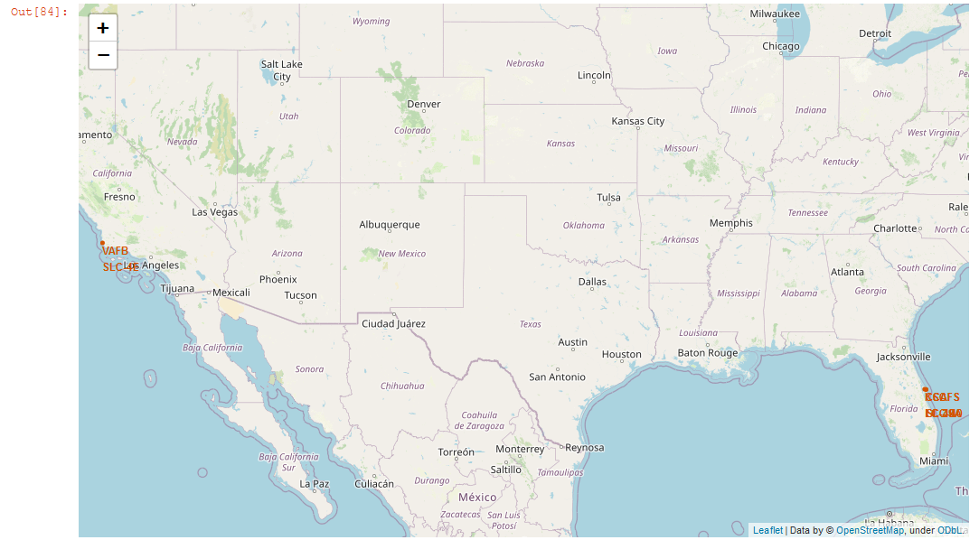
All Launch Sites on Map
We can see that the SpaceX launch sites are in the United States of America coasts. Florida and California.

Slide 36
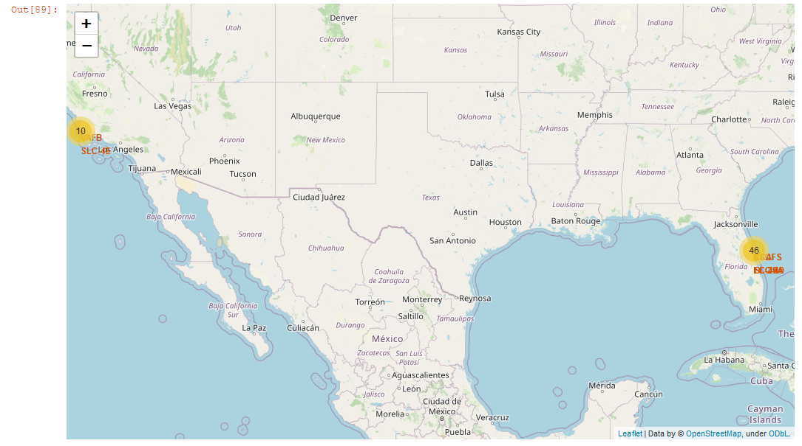
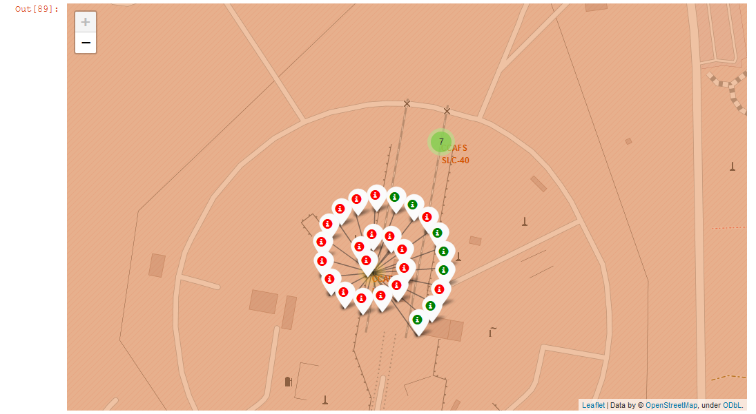
Success/failed launches for each site on the map
Green Marker shows successfulll launches and Red marker shows failures.

Slide 37
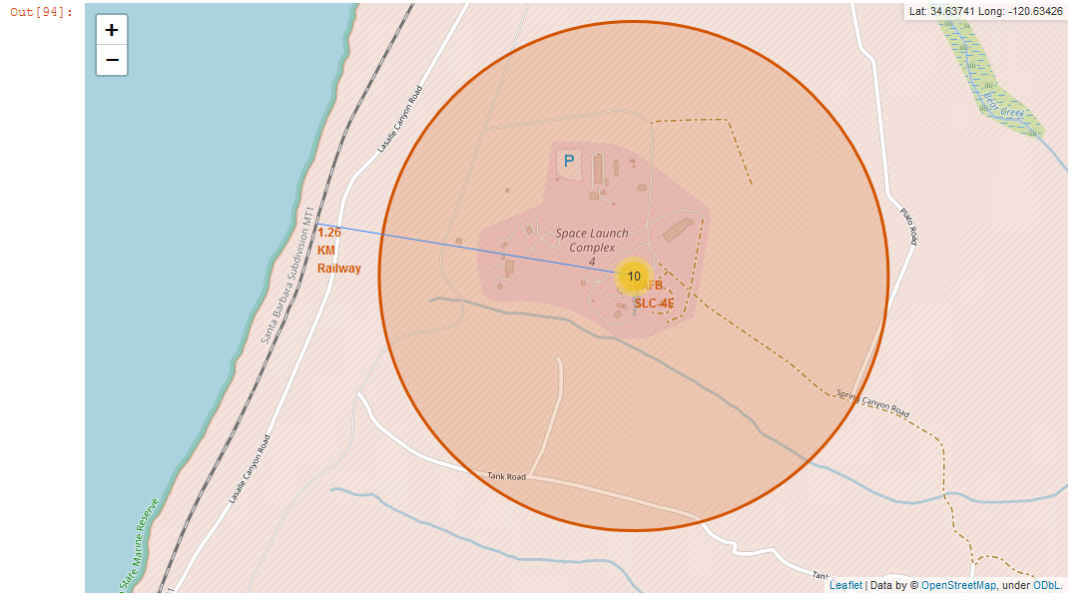
Distance from the Coastline
We can see that the launch site is 1.26KM away from the coastline.

Slide 38


Slide 39
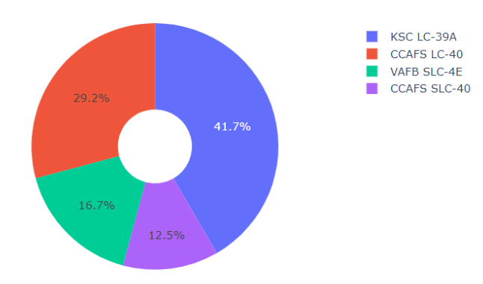
Pie chart showing the success percentage achieved by each launch site
We can see that KSC LC-39A had the most successful launches from all the sites

Slide 40
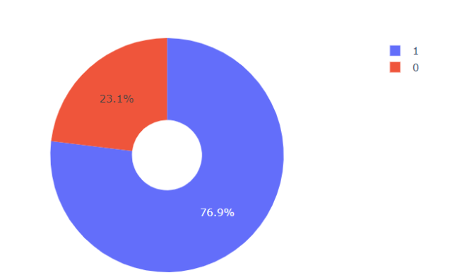
Pie chart for the launch site with highest launch success ratio
KSC LC-39A achieved a 76.9% success rate while getting a 23.1% failure rate

Slide 41
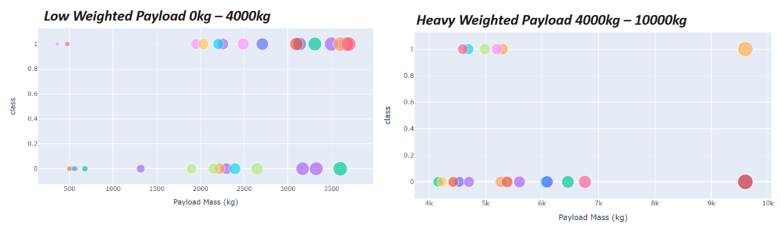
Payload vs. Launch Outcome scatter plot for all sites, with different payload selected in the range slider
We can see the success rates for low weighted payloads is higher than the heavy weighted payloads

Slide 42


Slide 43
Classification Accuracy
Decision tree classifier has the best accuracy.

Slide 44
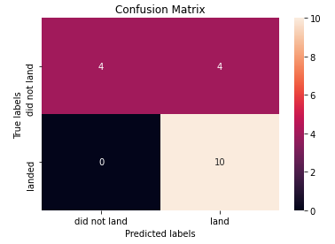
Confusion Matrix
Confusion matrix of the best performing model with an explanation

Slide 45
Conclusions
The Tree Classifier Algorithm is the best for Machine Learning for this dataset.
Low weighted payloads perform better than the heavier payloads.
The success rates for SpaceX launches is directly proportional time in years they will eventually perfect the launches.
We can see that KSC LC-39A had the most successful launches from all the sites.
Orbit GEO,HEO,SSO,ES-L1 has the best Success Rate

Slide 46
Appendix
Include any relevant assets like Python code snippets, SQL queries, charts, Notebook outputs, or data sets that you may have created during this project

Slide 47


